Slide 1
DATABASE PROJECT SUNSHINE HOSPITALS
Prepared By:
Garvit Patel (C0769187) Sachin Brahmbhatt (C0773445)
Janki Patel (C0773592) Kalhaar Savaj (C0777017)
Eshwar Raj Akke Lakshman (C0754226)

Slide 2
INTRODUCTION
COMPANY
SUNSHINE HOSPITAL
COMPANY TYPE
HEALTH CARE
COMPANY’S DESCRIPTION
THE NAME OF OUR COMPANY IS SUNSHINE HOSPITAL BASED IN CANADA.
IT HAS MANY SUB-BRANCHES ACROSS THE COUNTRY. THE MAIN BRANCH OF THE HOSPITAL IS LOCATED AT 334, MOORE PARK AVENUE, NORTH YORK, ONTARIO, CANADA - M2R 2R6.
IT PROVIDES 24*7 EMERGENCY SERVICES. IT HAS HIGH TECH LATEST MEDICAL EQUIPMENT AND HIGHLY QUALIFIED DOCTORS.
PRODUCTS
SUNSHINE HOSPITAL MANAGEMENT SYSTEMS

Slide 3

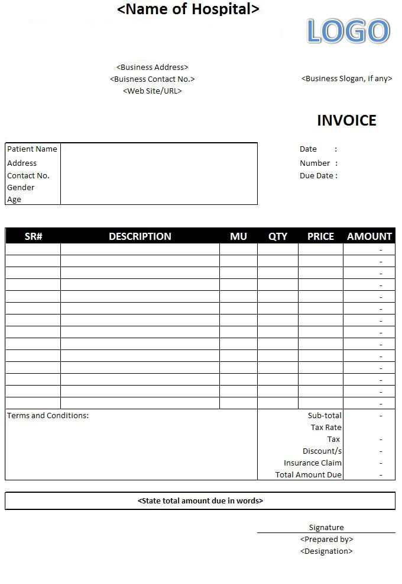
PATIENT INVOICE

Slide 4
ENTITY IDENTIFICATION
ENTITIES
PATIENT
HOSPITAL
EMPLOYEE
DOCTOR
NURSE
TRAINEE
INVOICE
RECORD
ROOM
MEDICINE

Slide 5
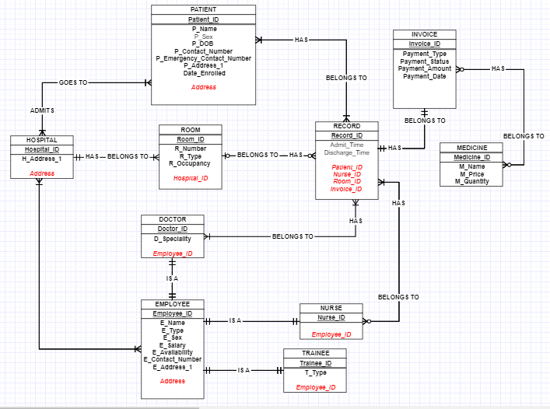
CONCEPTUAL MODEL ER DIAGRAM

Slide 6
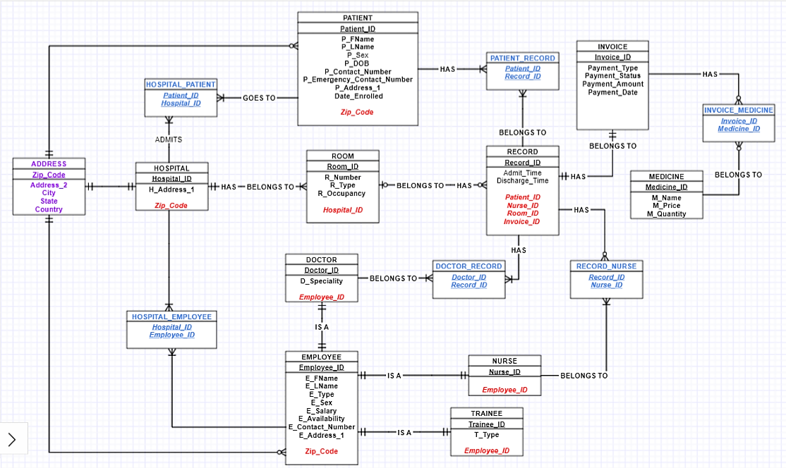
ER Diagram After Resolving Many to Many Relationship

Slide 7
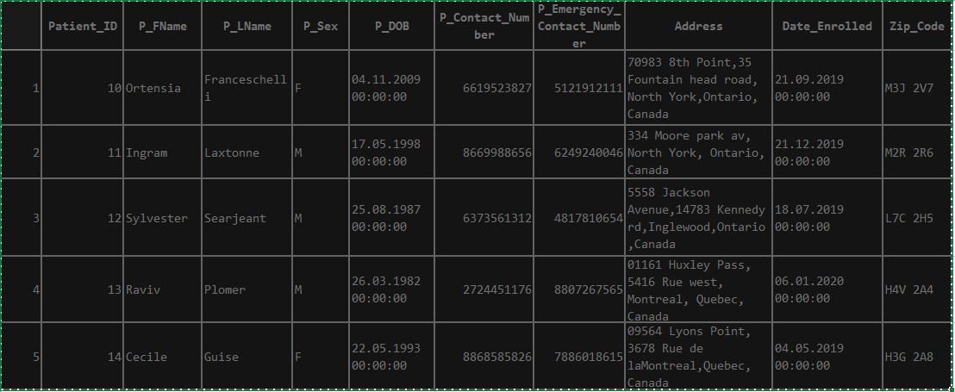
Logical Model
Without Normalization

Slide 8
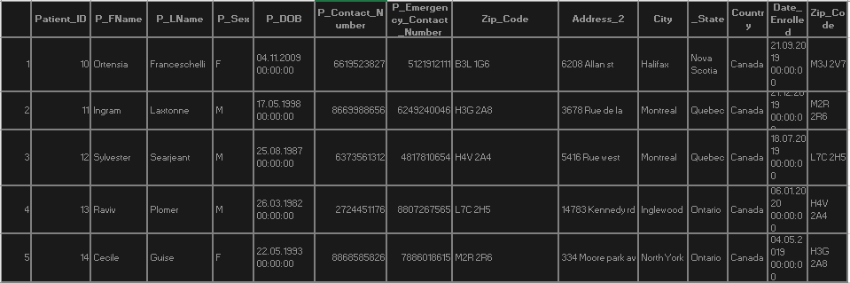
Logical Model
Table After 1 NF
It is already in 2NF form because there is no composite key

Slide 9
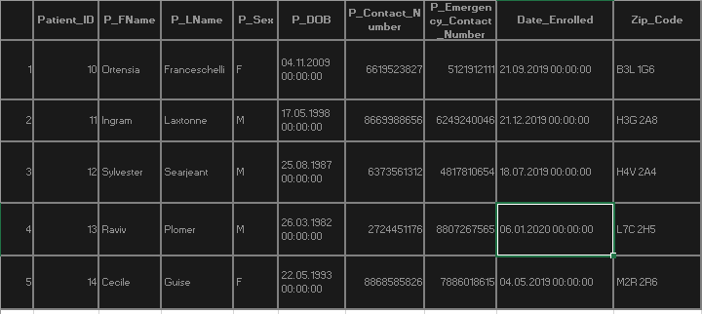
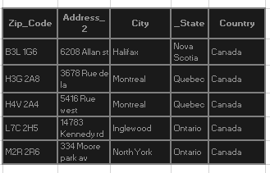
Logical Model
Table After 3 NF

Slide 10
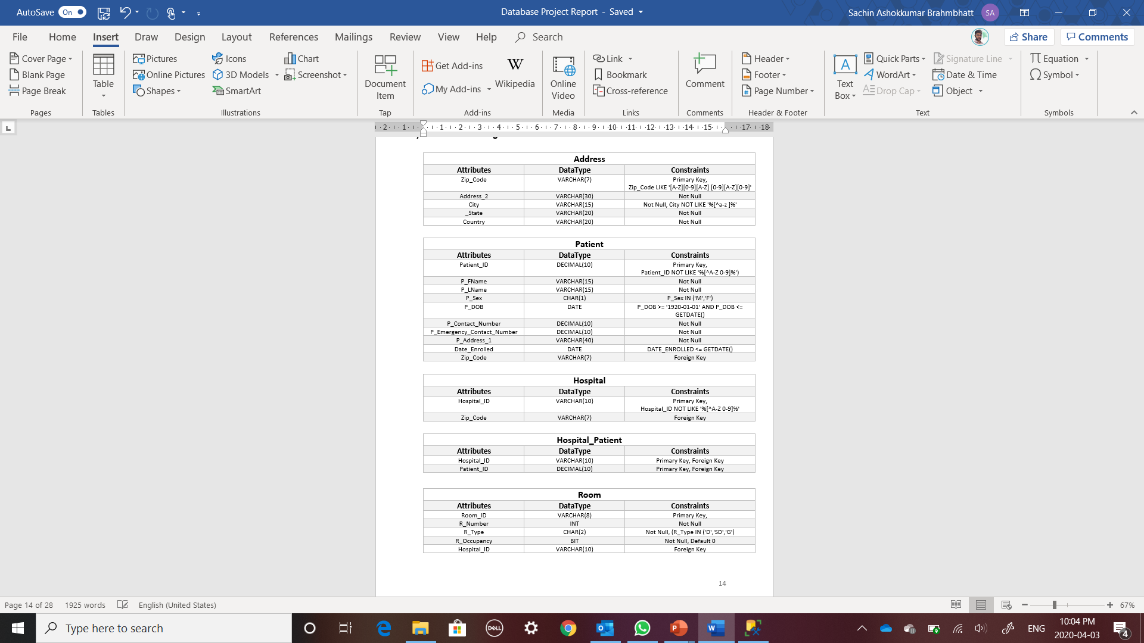
PHYSICAL MODEL WITH CONSTRAINTS

Slide 11

PHYSICAL MODEL WITH CONSTRAINTS: CONTD

Slide 12
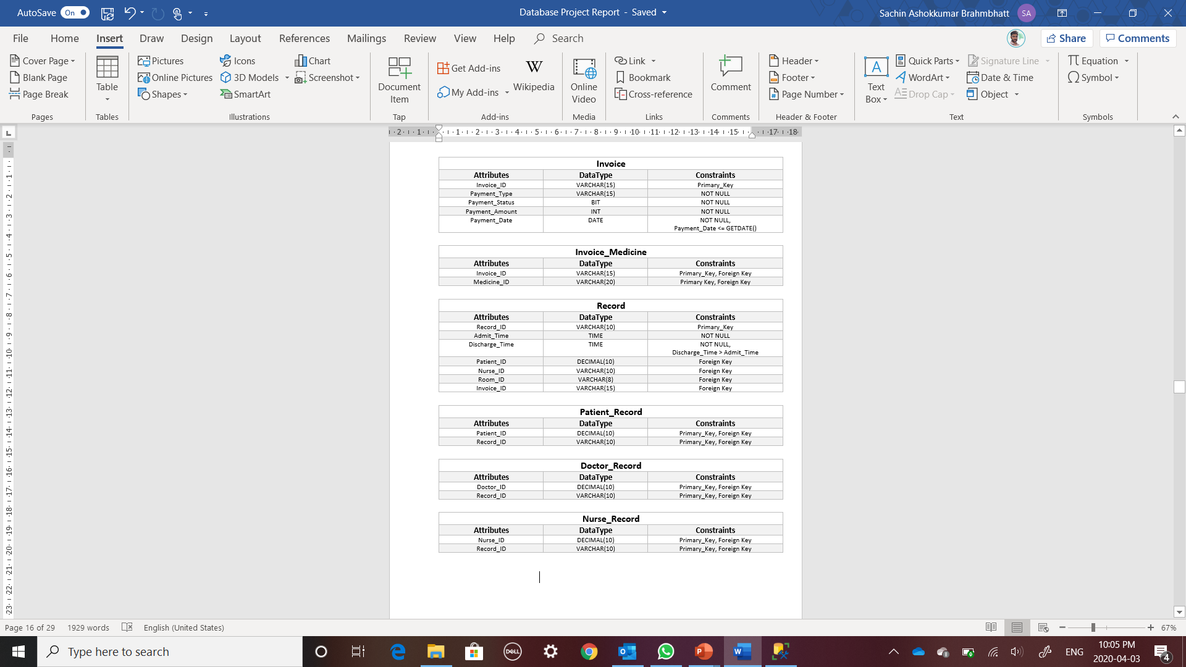
PHYSICAL MODEL with CONSTRAINTS: CONTD

Slide 13
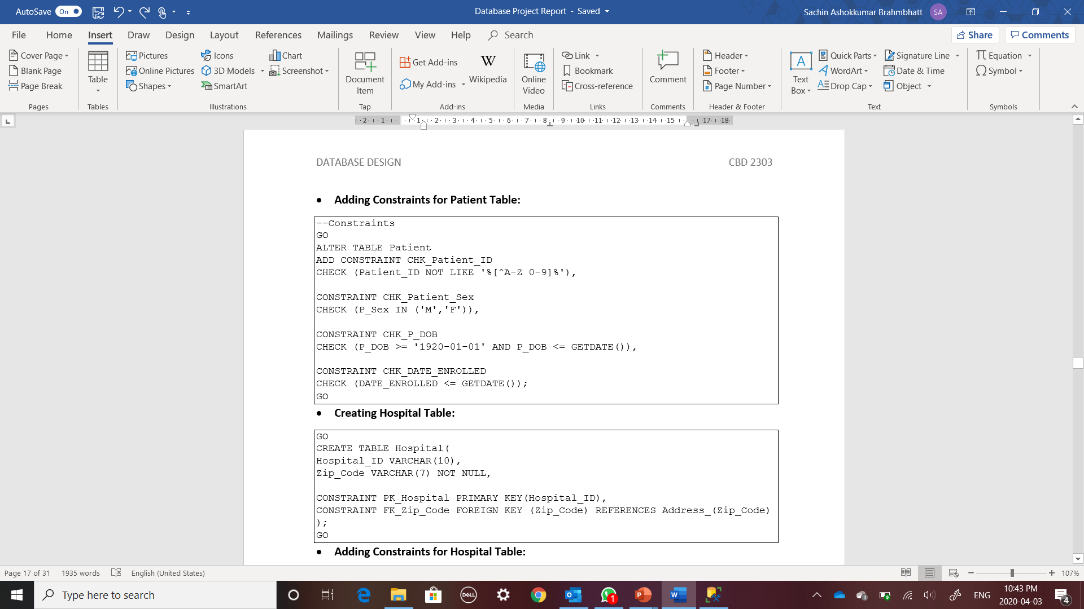
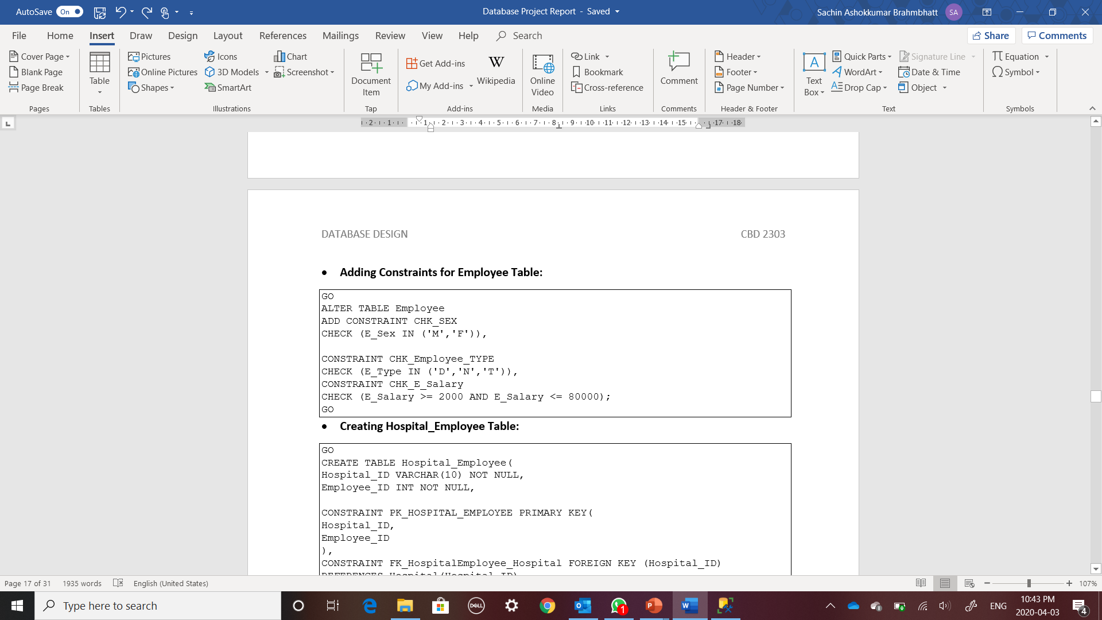
SQL SNIPPET OF CONSTRAINT

Slide 14
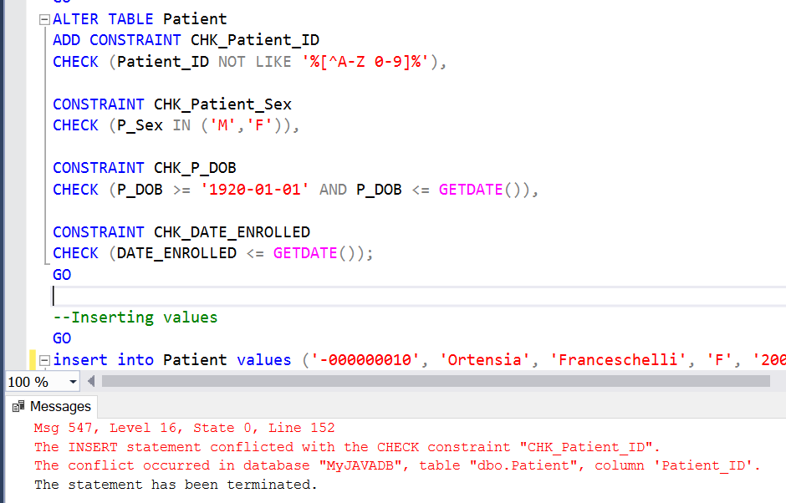
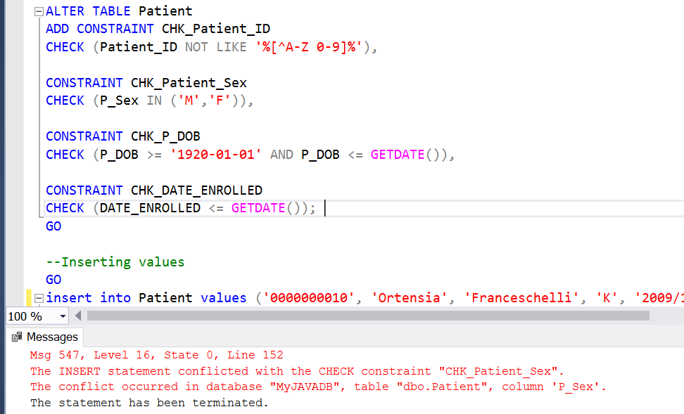
CONSTRAINT TESTING

Slide 15

ANY QUESTIONS?

Slide 16

THANK YOU

